Slide 1
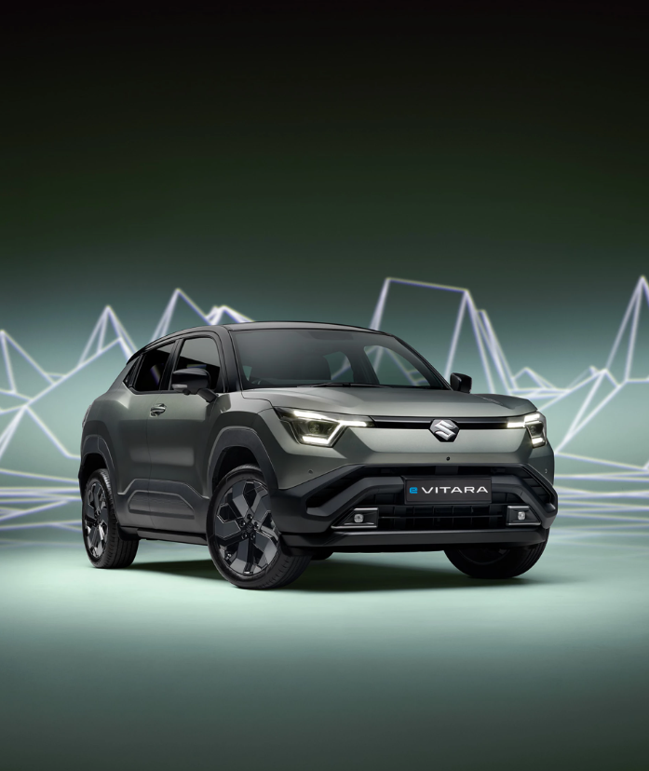
A Study Report on
ELECTRIC VEHICLE

Slide 2
1.a Vehicles: Global EV Outlook -4W (FY 25-26 Scenario)
Sales / Production figures in lakhs
World PV Sales 2025-26
India PV Sales 2025-26
Top 5 Countries– PV Car Sales 2025
Top 5 Countries Vs India – EV Car Sales 2025
~830 L
Total PV
~47 L
Total PV
Sales
*Production of light trucks not included
Top 5 EV Maker Countries – Production 2025
SN | World
 | Model | Sales
1 | Tesla Model Y | 16.5
2 | Tesla Model 3 | 7.5
3 | Geely Xingyuan | 4.66 (CN)
4 | Wuling Mini EV | 4.25 (CN)
5 | BYD Seagull | 3.11 (CN)
Top 5 Countries Vs India – EV Sales share 2025-26
Share
China dominates EV Production and Sales; However, EV fleet share of China is still lower (43%) due to huge market size.
Sources: IEA – Global EV Outlook 2026; Pew Research (IEA data), May 2026; Global Fleet – world sales 2025; CarNewsChina – China NEV ranking 2025; Vehicle counts in lakh units. CN-China
1/10

Slide 3
1.b Vehicles: India EV Outlook – 2W+3W+4W (FY 25-26 Scenario)
Sales figures in lakhs
Total Vehicle Sales FY26 by Segment
EV vs Non-EV Sales FY26 (2W+3W+4W)
EV Sales FY21–FY26 – 2W + 3W + 4W (lakh)
~274.88 L
~274.88 L
Electric 2W – Top 5 OEMs & Models
Electric 3W – Top 5 OEMs & Models
Electric 4W (PV) – Top 5 OEMs & Models
S. | OEM | Lakh
1 | TVS Motor | 3.42
2 | Bajaj Auto | 2.89
3 | Ather Energy | 2.39
4 | Ola Electric | 1.64
5 | Hero (Vida) | 1.44
Model | Lakh
TVS iQube | 3.4
Bajaj Chetak | 2.89
Ather Rizta | 1.67
Ola S1 series | 1.64
Hero Vida | 1.44
S. | OEM | Lakh
1 | Mahindra LMM | 1.02
2 | Bajaj Auto | 0.90
3 | YC Electric | 0.37
4 | TVS Motor | 0.28
5 | Saera Electric | 0.23
Model | Lakh
Mahindra Treo | 1.02
Bajaj GoGo | 0.90
YC Yatri | 0.37
TVS King EV Max | 0.28
Saera Mayuri | 0.23
S. | OEM | Lakh
1 | Tata Motors | 0.79
2 | JSW MG Motor | 0.53
3 | Mahindra | 0.43
4 | Hyundai | 0.06
5 | BYD India | 0.05
Model | Lakh
MG Windsor EV | 0.19
M&M XEV 9S | 0.18
Tata Nexon EV | 0.17
Tata Punch EV | 0.16
M&M XEV 9e | 0.11
Overall EV Share of vehicle segment = 3W~60% , 2W~6%, 4W~ 4% (EV penetration is still in single digit for vehicles sold in personal category)
Source: Autoguide India – FY22; Autocar Pro – FY2024; Autocar Pro – FY2025; Autocar Pro – FY2026; EVreporter – FY2025-26 EV sales; Vahan Dashboard; Autocar Pro – e-2W FY2026; Bikeleague – e-2W models FY26; Autocar Pro – e-3W FY2026;
2/10

Slide 4

1.c Vehicles: India EV Outlook -4W (FY 25-26 & FY 26-27)
e-PV Sales FY21 – FY26 (lakh)
Monthly e-PV Sales FY27 (Apr–Oct 2026, lakh)
Top 5 e-PV Companies – FY27 YTD (Apr–Oct)
GST 2.0 in Sep’25
# | Company | Sales (lakh) | Share
1 | Tata Motors | 0.89 | 40%
2 | Mahindra & Mahindra | 0.51 | 23%
3 | JSW MG Motor | 0.38 | 17%
4 | VinFast India | 0.14 | 6%
5 | Maruti Suzuki | 0.09 | 4%
FAME-11 end in Mar’24
Sales
Sales
Vahan retail; Oct = Vahan, 3 Nov 2026 (36,064 units, +77% YoY)
Top 5 e-PV Models (Apr–Oct 2026)
SN | Model | OEM | Sales (lakh)
1 | Tata Punch EV | Tata | 0.276
2 | Mahindra XEV 9S | M&M | 0.274
3 | MG Windsor | JSW MG | 0.251
4 | Tata Nexon EV | Tata | 0.196
5 | Mahindra XEV 9e | M&M | 0.11
Lowest YoY growth in FY24-25 due to absence of EV subsidy.
3/10

Slide 5
2.a Policy: PM E-DRIVE Scheme – Components, Targets & Progress
Launched Sep 2024 (₹10,900 cr); outlay now ₹11,900 cr and tenure extended to 31 Mar 2028 – fund-limited, closes per segment once money runs out
Component | Outlay (₹ cr) | Target | Status
e-2W demand incentive | 2,767 | 45.79 lakh e-2W (orig. 24.79 lakh) | Extended to March’28
e-3W (L5 autos) | Within ₹3,679 cr demand pool | 3.16 lakh e-3W | Closed 26 Dec 2025
e-rickshaw / e-cart | Within demand pool | — | Open (FY26–FY28)
e-ambulances | 500 | — | Active
e-trucks | 500 | Diesel truck scrappage linked | Active
e-buses | 4,391 | 14,028 e-buses | 13,800 allotted to 7 cities
Public charging | 2,000 | 72,300 chargers | ₹851 cr approved, 8,147 chargers
Testing agencies | 780 | Upgrade MHI test centres | Active
Total scheme | 11,900 | Till 31 Mar 2028 | Fund-limited
Current active Policies offered by States
State | Car incentive | Valid till
Telangana | 100% road tax + registration waiver | 31 Dec 2026
Tamil Nadu | 100% road tax + registration waiver | 31 Dec 2027
Delhi | Road tax + registration exemption | 31 Mar 2030
Maharashtra | Road tax + registration waiver | 2030
Source: PIB – Cabinet approval (11 Sep 2024); extension (8 Aug 2025); Lok Sabha reply (28 Jul 2026); PM E-DRIVE update (1 Oct 2026)
4/10

Slide 6
2.b Policy: Cabinet, 4 Nov 2026 – BESS, LFP & Critical Minerals
Two schemes: demand push for grid batteries (40% local content) + supply push for battery-lithium & nickel
1. Energy storage: BESS & pumped hydro
2. Critical minerals: lithium & nickel refining
Parameter | VGF – Grid-Scale Energy Storage
Ministry | Ministry of Power
Outlay & tenure | ₹14,500 cr viability gap funding (VGF); FY27 – FY31
Capacity | 92 GWh new grid storage = 60 GWh pumped hydro + 30 GWh BESS + 2 GWh emerging tech
Investment | ~₹97,600 cr expected
Local content | Minimum 40% domestic content (DCR) for BESS projects
How awarded | Tariff-based competitive bidding; VGF to public & private DISCOMs
Why | Adds ~170% to existing grid storage; India needs 411 GWh by FY32
LFP link | Grid BESS runs mostly on LFP cells – DCR gives assured demand for Indian LFP cells & packs
Parameter | Critical Mineral Processing
Ministry | Ministry of Mines – Capex Support Scheme for Critical Mineral Processing
Outlay & tenure | ₹2,814 cr (₹2,800 cr subsidy + ₹14 cr admin); FY27 – FY31
Plants | 2 lithium (≥30 kt each) + 2 nickel (≥50 kt each); cobalt as by-product
Output | Battery-grade lithium compounds; Class-1 nickel / battery-grade nickel sulphate
Incentive | 30% capex subsidy; cap ₹500 cr per Li plant, ₹900 cr per Ni plant
Selection | 2-stage: technical, then lowest capex support sought; paid in 3 milestone tranches
Timeline | Commission within 3 yrs of award (max 5); 60 kt Li + 100 kt Ni by 2030; ~₹10,000 cr investment
LFP link | Battery-grade lithium is the key LFP cathode input (iron & phosphate are abundant)
Source: Union Cabinet decisions, 4 Nov 2026 – Drishti IAS (6 Nov 2026); TaiyangNews (5 Nov 2026); Energetica India (4 Nov 2026); Greater Kashmir (4 Nov 2026)
5/10

Slide 7
2.c World EV News – Oct / Nov 2026
China scales up and exports harder; Europe grows fast; US slumps after tax-credit expiry; UK softens its mandate
SN | Region / Company | News | Key numbers
1 | China – market | October NEV wholesale estimated at a fresh high (CPCA preliminary) | ~1.8 mn NEVs, +12% YoY
2 | China – exports | Second straight monthly export record (BEV + PHEV, incl. overseas plants) | 582k in Oct, +145% YoY (Sep: 558k)
3 | BYD | First month above 300k BEVs; PHEV falling; BEV sales alone beat US Q3 EV total | 490k total; BEV 306k (+37%); PHEV 177k (-17%); overseas 170k
4 | Global (Sep) | Global EV sales broadly flat; growth shifting to Europe and rest of world | Sep 2.15 mn (-2% YoY); YTD 15.5 mn (+3%)
5 | Europe | Record month; BEVs growing faster than PHEVs | Sep 0.60 mn (+39%); YTD 3.9 mn (+30%)
6 | North America | Slump after $7,500 federal tax credit ended (Sep-25 pre-buy base) | Sep 0.13 mn (-44%); YTD 1.2 mn (-24%)
7 | Trade policy | EU proposes cap on Chinese-built EVs; China cuts export VAT rebate | EU cap 350k for 2027 (pending); rebate 13% → 9% from 1 Apr 2027
8 | UK | Govt set to ease ZEV mandate; petrol/diesel-only ban stays 2030 (decision expected) | 2030 BEV share 80% → 60% proposed; rest hybrids
1/1

Slide 8
3.a Battery: Five generations of the electric-vehicle battery
GEN 1
GEN 2
GEN 3
GEN 4
GEN 5
1900s – 2000s
2008 – 2015
2015 – today
emerging now
late 2020s – 2030s
Lead–acid · NiMH
LCO · LMO · NCA
NMC · LFP
Sodium-ion · Silicon anode
Solid-state
Water-based chemistry. Cheap and dependable, but the electrodes are consumed as they work and a single cell tops out near 2 volts.
Lithium moves through an organic solvent and inserts itself into a host lattice that stays intact. Range becomes a commercial proposition.
The market splits in two. Nickel-rich NMC buys range for premium cars; cobalt-free LFP buys safety and low cost for the mass market.
Sodium replaces scarce lithium in cheap city cars. Silicon in the anode holds far more lithium than graphite if the swelling can be contained.
The liquid disappears. A solid ceramic or polymer separator removes the fire risk and opens the door to a pure lithium-metal anode.
HELD BACK BY
HELD BACK BY
HELD BACK BY
HELD BACK BY
HELD BACK BY
Weight. A usable range meant a pack no car could carry.
Cost and cobalt. Cells came from consumer electronics.
Nickel supply, and a Chinese lock on LFP refining.
Silicon expands up to 300% and cracks the anode.
Manufacturing. Nobody builds these at automotive scale.
SPECIFIC ENERGY
SPECIFIC ENERGY
SPECIFIC ENERGY
SPECIFIC ENERGY
SPECIFIC ENERGY
30–80
Wh/kg
11% of the 500 Wh/kg ceiling
100–260
Wh/kg
36% of the 500 Wh/kg ceiling
90–250
Wh/kg
34% of the 500 Wh/kg ceiling
120–300
Wh/kg
42% of the 500 Wh/kg ceiling
350–500
Wh/kg
85% of the 500 Wh/kg ceiling
GM EV1 · Toyota Prius
Tesla Roadster · Nissan Leaf
VW ID.4 · BYD Blade · Tata Curvv
CATL sodium-ion · silicon-blend packs
Toyota · Quantum Scape (pilot lines)
Sources S&P Global Mobility: evolution of EV battery technology · Battery University BU-205 · InsideEVs: NMC, LFP and solid-state
6/10

Slide 9
3.b Battery: Chemistry & mechanism : Gen-1 & Gen-2
TECHNOLOGY | INSIDE THE CELL anode · electrolyte · cathode | CARRIER | HOW IT WORKS | WHAT HOLDS IT BACK | Wh/kg
Lead–acid Flooded lead plates · 1859 | Pb → H₂SO₄ → PbO₂ | SO₄²⁻ | Both plates turn to lead sulphate as the cell discharges. The acid is a reactant, not just a medium — the electrodes are consumed and rebuilt on every cycle. | Heavy, gasses on overcharge, roughly 300 cycles | 30–40
NiMH Nickel–metal hydride · 1990s | MH → KOH → NiOOH | OH⁻ | Hydrogen, not lithium, does the work. It is absorbed into a metal alloy on one side and released on the other — proton transfer rather than ion insertion. | Self-discharges, runs hot, only 1.2 volts per cell | 60–80
LCO Lithium cobalt oxide · 2008 | C₆ → LiPF₆ → LiCoO₂ | Li⁺ | Lithium slides between flat sheets of cobalt oxide and back out again. Nothing is consumed — the host lattice simply holds the ions until they are called for. | Slow charging, short life, cobalt cost and sourcing | 150–200
LMO Lithium manganese oxide · 2010 | C₆ → LiPF₆ → LiMn₂O₄ | Li⁺ | The same idea, but lithium travels through a three-dimensional spinel framework instead of flat sheets. Less resistance, more current, safer when hot. | Manganese leaches into the electrolyte; poor calendar life | 100–150
NCA Nickel cobalt aluminium · 2012 | C₆ → LiPF₆ → LiNiCoAlO₂ | Li⁺ | Mostly nickel, which stores the most lithium. A little aluminium is added purely to stop the nickel-rich lattice from collapsing as it is cycled. | Narrow safe window; needs liquid cooling and a strict BMS | 200–260
Sources Battery University BU-205 · GM EV1 (lead-acid vs NiMH) · Nickel-metal hydride · InsideEVs: EV battery chemistries
7/10

Slide 10
3.c Battery: Gen-3: NMC or LFP
Same anode. Same electrolyte. Only the cathode differs.
That single choice sets range, cost, safety and cycle life — which is why carmakers now fit both, one per trim level, on the same platform.
Graphite
LiPF₆ in carbonate
NMC or LFP
Li⁺
anode
electrolyte
cathode
 | NMC | LFP
Cathode formula | LiNiMnCoO₂ | LiFePO₄
How the cathode works | Layered oxide. Nickel stores the lithium, manganese stabilises the structure, cobalt keeps the layers ordered. More nickel, more energy, less stability. | Olivine framework. Phosphorus holds the oxygen in strong bonds, so heat does not release it — a failing cell smoulders rather than ignites.
Specific energy | 150–250 Wh/kg | 90–160 Wh/kg
Cycle life | 1,000–2,000 cycles | 3,000–6,000 cycles
Thermal runaway begins | around 210 °C | around 270 °C
Critical minerals | Nickel and cobalt | None — iron and phosphate
Where you see it | VW ID.4 · Hyundai Ioniq 5 · most European and Korean EVs | BYD Blade · Tesla standard range · Tata Curvv and Nexon 45 kWh
Sources InsideEVs: NMC, LFP and solid-state explained · Battery University BU-205 · MRS Bulletin: advanced materials supply for EVs
8/10

Slide 11
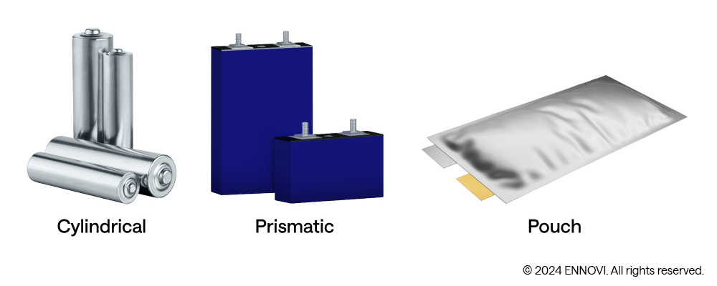
3.d Different Types of Cells and their Alignment for EV
Cylindrical
Prismatic
Pouch
Steel can, wound jelly roll
Small: 18650, 2170, 4680
Strong case with built-in vent and safety cut-off
Hundreds to thousands per pack
Tesla, most e-scooters
Aluminium box, flat roll or stack
Large: 50–300+ Ah each
Packs tightly, easy to cool
About 100–200 per pack
BYD, CATL, Tata
Soft foil bag, stacked sheets
Light, flexible shape
Needs a frame to hold and protect it
Swells with age; must be kept pressed
LG, SK On, Hyundai, GM
How the cells are arranged in the car
Cell-to-module (CTM)
Cell-to-pack (CTP)
Cell-to-body (CTB)
pack = car floor
Cells → modules → pack. A faulty module can be swapped, but the extra frames waste space and add parts.
No modules: about 15–30% more room for cells, fewer parts, lower cost. Harder to repair. BYD Blade, CATL Qilin.
The pack lid is the car floor and carries load. Lighter, stiffer body; very hard to repair or reuse. BYD Seal, Tesla Model Y.

Slide 12
3.d Battery: Cell Manufacturing Capacity
Global (Current Capacity - 1189 GWh)
India (Current Capacity - 1.4 GWh)
CHINA
India market, FY2025–26 | Figure
EV sales | 2.5 million+ (+24%)
Cell PLI scheme (₹18,100 cr) | 50 GWh target; ~1–1.4 GWh running
S. KOREA
JAPAN
India’s Cell Manufacturing Capacity
Cell plant | Planned | Status (Oct 2026)
Ola Electric, Tamil Nadu | 20 GWh | ~1.4 GWh installed
Reliance, Gujarat | 15 GWh | Ramping up in 2026
Exide, Karnataka | 6 GWh (phase 1) | Commissioning
Amara Raja, Telangana | 4 GWh (phase 1) | Start FY27
Tata Agratas, Gujarat | 20 GWh+ | Under construction
Global snapshot | Figure
EV batteries installed, 2025 | 1,187 GWh ; CATL + BYD = 56%
China’s share of mineral refining | 70–95% (graphite >95%)
Average pack price, 2025 | $108/kWh (LFP $81, NMC $128)
India’s gap: EV demand is growing; however, battery manufacturing is still lagging.
Sources: CnEVPost – SNE Research 2025; Mercom – IEA minerals 2025; BNEF – pack prices, Dec 2025; EVreporter – FY2025-26 EV sales; pv magazine – PLI ACC, Mar 2026; The Machine Maker – Exide; The Machine Maker – Amara Raja
9/10

Slide 13
4.a Charging Infra: EV Charging Infrastructure
Top Charge point Operator
Operator | Network size (latest company disclosure)
Tata Power | 6,700+ charger points; 1,200+ e-bus points; 2.5 lakh+ home chargers
ChargeZone | 15,000+ charging points at 1,200+ locations (India and UAE); 120 MW installed
Statiq | 10,000+ AC and DC points, 100+ cities
Jio-bp pulse | 7,000+ active points, 300+ cities
HPCL | 5,600+ charging stations; 150+ battery-swap stations
IOCL, BPCL, HPCL (combined) | 27,432 charging stations at fuel retail outlets
Total
~52,718
OEM | Model | Current network
Hyundai | Own DC network + app aggregation | 185 charging stations
Mahindra | Charge_IN (own) | 50 stations
Tata Motors (TATA.ev) | Open Collaboration with CPOs | 2,500 community &750 dealer chargers
Maruti Suzuki | Own + 13 CPO partners | 2,000+ charging points
Ather Energy (2W) | Ather Grid | 3,675+ own fast chargers
Ola Electric (2W) | Hypercharger | 288 charging points
India’s Charging infra discussion has moved from too few chargers to too few reliable fast chargers where drivers need them.
Source :-
Sansad data, Lok Sabha written reply, Ministry of Heavy Industries, 16 Dec 2025 (PIB PRID 2204635), Tata Power (Sep 2026) · DeshGujarat, ChargeZone (Sep 2026) · YourStory, EVreporter: Statiq (Feb 2026) · Hyundai–Jio-bp release (Aug 2026) · Mahindra–HPCL release (Sep 2026) · MoPNG year-end review 2025

Slide 14
4.b Strategy to FY31: Maruti vs Tata vs Mahindra (FY26 Annual Reports)
FY26 integrated annual reports; items marked (press) come from AGM, investor day or media, not the report
Item | Maruti Suzuki | Tata Motors PV | Mahindra (Auto)
New EV launches | 4 BEVs by FY31 (incl. e Vitara) | 5 new EV models by FY30 | 6 EVs by 2031; BE.07 in 2027 (press)
Other new products | 7 new SUVs in next 5 years | 6 nameplates + 20+ refreshes by FY31 (press) | New SUVs on 4G & monocoque platforms (NU_IQ, INGLO); 10 ICE models by 2031 (press)
EV share target | BEV 15% of domestic sales by FY31 | EVs >30% of own volumes by FY31 (press) | No target; EV = 9.6% of SUV sales in Q4 FY26
Other powertrains (FY31) | CNG 35%, strong hybrid 25%, biofuel-blend 25% of domestic sales | No rush to bring hybrids (press) | NU_IQ: modular multi-energy platform
EV position / aim | No. 1 in BEV production, domestic sales & exports by FY31 | FY26: 89,393 EVs domestic; 40.2% EV share (Vahan); steady-state 45–50% EV share (press) | No. 1 E-SUV by revenue (37.4%); E-SUVs margin-positive in year 1
Capex | ₹35,000 cr – proposed Khoraj (Gujarat) plant | ₹33,000–35,000 cr for PV + EV, FY26–FY30; ₹16,000–18,000 cr for EV, FY25–30 (press) | Phased capacity expansion; ₹37,000 cr FY25–27 incl. ₹12,000 cr EV (press)
Capacity | 2.9 mn units by FY27; 3.65 mn by FY31 | Not stated | 64.5k/month; Chakan NU_IQ by FY28; Nagpur from 2028
Battery cells | TDSG Gujarat: cells localised to electrode level (18 mn cells/yr) | Working with Agratas on supply chain; Agratas NMC cells from early 2027 (press) | BYD LFP cells for INGLO EVs (press)
Charging | 1 lakh+ charge points by FY31 | 200+ Mega Charging Hubs; 4 lakh charge points by 2027 | Charge_iN ultrafast network; no number
Exports | e Vitara to 100+ countries; 40,873 exported | Re-entered South Africa | Phased global expansion; 35k-unit Indonesia order
1/1

Slide 15
Sources
Slide Name | Source links (click to open)
1.a Vehicles: Global EV Outlook – 4W | IEA – Global EV Outlook 2026; Pew Research (IEA data), May 2026; Global Fleet – world sales 2025; CarNewsChina – China NEV ranking 2025; ClubAlfa – Model Y 2025 estimate; CGTN – China NEV output 2025; electrive – VDA, Feb 2026
1.b Vehicles: India EV Outlook – 2W+3W+4W | Autoguide India – FY22; Autocar Pro – FY2024; Autocar Pro – FY2025; Autocar Pro – FY2026; EVreporter – FY2025-26 EV sales; Vahan Dashboard; Autocar Pro – e-2W FY2026; Bikeleague – e-2W models FY26; Autocar Pro – e-3W FY2026; Autocar India – e-4W FY2026; AutoPunditz – H1 2026 models
1.c Vehicles: India EV Outlook – 4W | Autocar Pro – FY2026; EVreporter – FY2025-26 EV sales; EVreporter – e-4W Q1 FY27; Autocar Pro – Jun–Aug 2026; Autocar India – Sep 2026; EVreporter – Sep 2026; AutoPunditz – H1 2026 models; Analytics Insight – Aug 2026; Autocar India – e-4W FY2026; AutoPunditz – Oct 2026 (Vahan); Rushlane – Oct 2026 brand-wise; Business Today – Oct 2026 models
2.a Policy: PM E-DRIVE Scheme | PM India – Cabinet note, Sep 2024; Indian Infrastructure – extension, Aug 2025; PIB 2317890 – 1 Oct 2026; IANS – e-2W extension, 11 Aug 2026; MeraEV – state subsidies, Jul 2026
2.b & 2c Policy: 4 Nov 2026 Cabinet approvals – BESS & critical minerals | Drishti IAS – VGF scheme for grid-scale ESS; Drishti IAS – Critical mineral processing scheme; TaiyangNews – two new schemes; Energetica India – VGF approval; Greater Kashmir – ₹2,814 cr schemeCPCA via Gasgoo (4 Nov 2026); Kantan News (Nov 2026); Electrek (2 Nov & 15 Oct 2026, Benchmark Mineral Intelligence data); electrive (19 Oct 2026); Autocar (Nov 2026)
3.a–3.c Battery: Generations, Chemistry & Mechanism, NMC vs LFP | S&P Global Mobility; Battery University BU-205; Wikipedia – GM EV1; Wikipedia – NiMH battery; InsideEVs – chemistries; MRS Bulletin
3.d Battery: Cell Manufacturing Capacity | CnEVPost – SNE Research 2025; Mercom – IEA minerals 2025; BNEF – pack prices, Dec 2025; EVreporter – FY2025-26 EV sales; pv magazine – PLI ACC, Mar 2026; The Machine Maker – Exide; The Machine Maker – Amara Raja
4.a -4.b Charging Infra: EV Charging Infrastructure , Strategy to FY31: Maruti vs Tata vs Mahindra (FY26 Annual Reports) | Source: FY26 Integrated Annual Reports – Maruti Suzuki, Tata Motors PV, Mahindra & Mahindra. (press) = Autocar Pro, Business Today, Outlook Business, Autocar India, Multibagg, Sansad data, Lok Sabha written reply, Ministry of Heavy Industries, 16 Dec 2025 (PIB PRID 2204635), Tata Power (Sep 2026) · DeshGujarat, ChargeZone (Sep 2026) · YourStory, EVreporter: Statiq (Feb 2026) · Hyundai–Jio-bp release (Aug 2026) · Mahindra–HPCL release (Sep 2026) · MoPNG year-end review 2025
10/10

Slide 16
Thank You

